Slide 1



ShanghaiTech GeekPie_HPC ISC22 Report

Slide 2
Agenda
About the team
Applications
NWChem
ICON
XCompact3d + Coding Challenge
Innovation

Slide 3
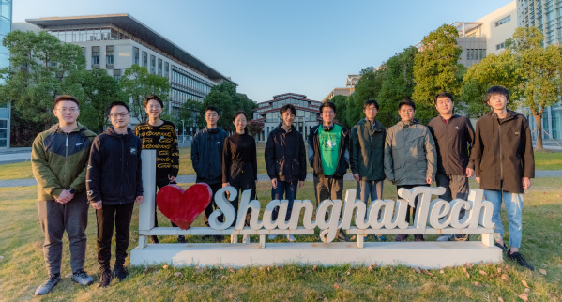

The Team
Chen Jiajun
GeekPie_HPC Team Leader, Sophomore
Interesting Area: System, Network, HPC
Li Zecheng
GeekPie_HPC Teammate, Junior
Interesting Area: System, Programming Languages
Xu Zike
GeekPie_HPC Teammate, Sophomore
Interesting Area: Differentiable rendering, Computer Graphics
Zhang Siyuan
GeekPie_HPC Teammate, Junior
Interesting Area: MLSYS, HPC for AI, Computer Vision
Qin Feiran
GeekPie_HPC Teammate, Junior
Interesting Area: Network, System, Program Languages
Yin Shu
GeekPie_HPC Advisor
Parallel and Distributed Storage Systems, High Performance File Systems, Storage System Reliability Analysis and Fault Tolerance, Big Data Analysis
Peng Cheng
GeekPie_HPC Teammate, Sophomore
Interesting Area: Network, System, Program Languages

Slide 4
The Team
Chen Jiajun
GeekPie_HPC Team Leader, Sophomore
Interesting Area: System, Network, HPC
Li Zecheng
GeekPie_HPC Teammate, Junior
Interesting Area: System, Programming Languages
NWChem
ICON
XCompact3d
Coding Challenge
Xu Zike
GeekPie_HPC Teammate, Sophomore
Interesting Area: Differentiable rendering, Computer Graphics
Zhang Siyuan
GeekPie_HPC Teammate, Junior
Interesting Area: MLSYS, HPC for AI, Computer Vision
Qin Feiran
GeekPie_HPC Teammate, Junior
Interesting Area: Network, System, Program Languages
Peng Cheng
GeekPie_HPC Teammate, Sophomore
Interesting Area: Network, System, Program Languages

Slide 5

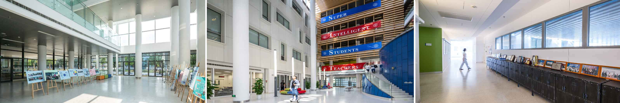
University/Institute

Slide 6
NWChem Overview
Computational chemistry software
Input some chemistry stuff and specify the routines, output some density function or energy values.
Objective: Minimize wall time
For us without chemistry background, carefully choose libraries, tuning parameters and do some general runtime optimizations (like core binding) should be fine.
Our work
Compiled and ran NWChem on both supercomputers successfully.
Tested various combinations of compilers, MPI and BLAS on both supercomputers.
Profiled NWChem to understand the GA communication behaviors.
Tuned the performance by adjusting input files and applying some runtime tricks.

Slide 7
Performance tuning
First, we choose the w5 input of TCE as a performance baseline.

Slide 8
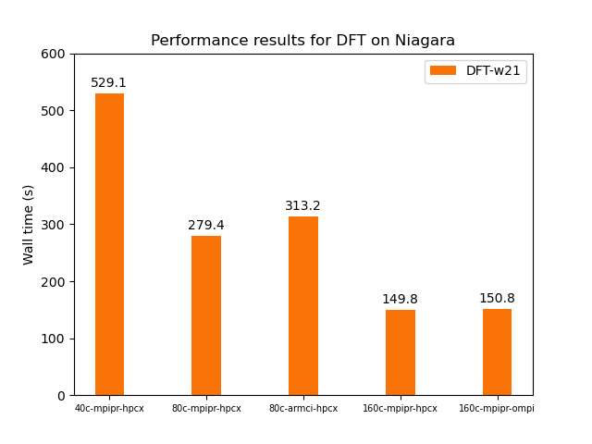
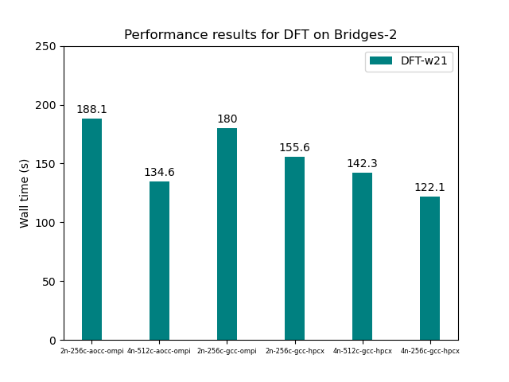
Performance tuning
Then we found a fastest configuration for one input is not the fastest for others

Slide 9
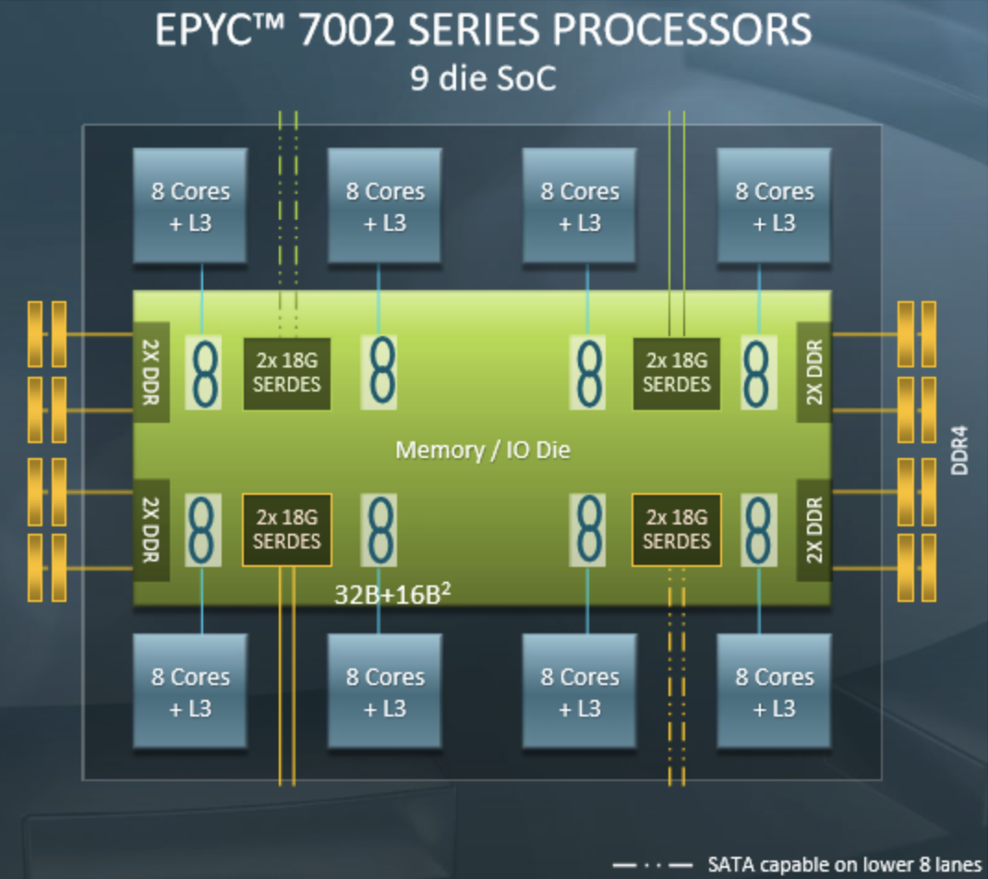
AMD Zen2 architecture
CCX-based
Each CCX has 8 cores, these cores shares a L3 and communications inside one CCX will be faster than cross-CCX.
Makes a difference in OpenMP performance, but has a smaller impact on MPI communications.

Slide 10
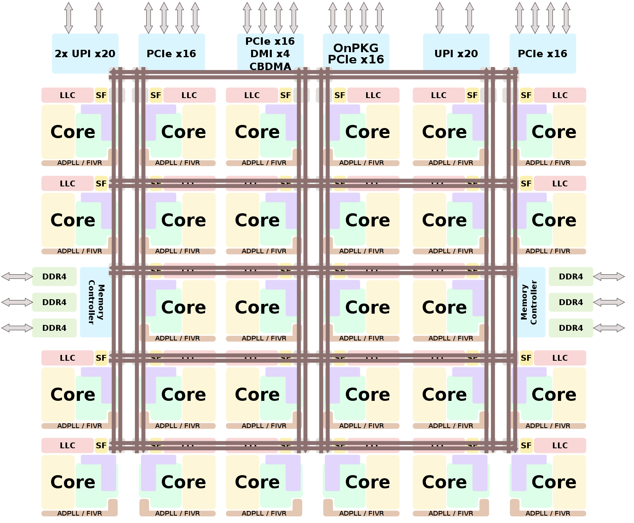
Niagara configurations
Skylake is using a ring bus interconnect to interlink multiple cores together, which may have less impact on OpenMP, but LLC is not uniform on such a big chip.
NUMA still counts!
Niagara did not disable hyper threading, which may impact performance of NWChem.

Slide 11
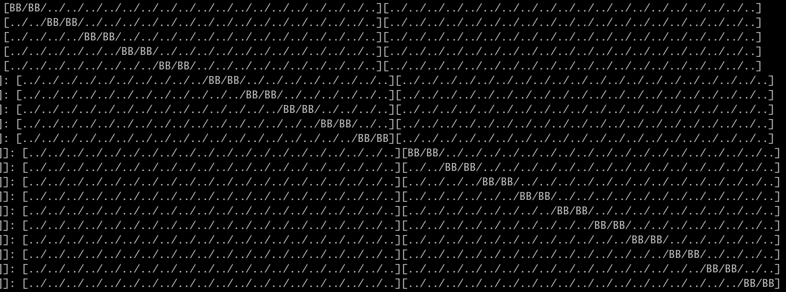
Solution: MPI —map-by option
mpirun -np 20 --bind-to core --map-by ppr:10:socket:pe=2 —report-bindings $NWCHEM $INPUT
For Bridges-2, OMP_PROC_BIND=close should be fine.
For Niagara, KMP_AFFINITY=scatter yields better performance.

Slide 12
OpenMP scaling result
For faster experiments, we skipped many iterations on CCSD by keeping the vector file *.t2

Slide 13
GPU Acceleration
On Bridges-2, GPU nodes are using Intel CPUs, we changed the math library to MKL.
If our MPI process number exceeds the available GPU devices, GPU performance will decrease significantly. (4 MPI processes -> 20 MPI processes will make GPU performance on CCSD(T) iterations decrease from ~3300GFlops to ~300GFlops).
To utilize CPU resources when executing the routines without GPU, we should enable OpenMP threading.

Slide 14
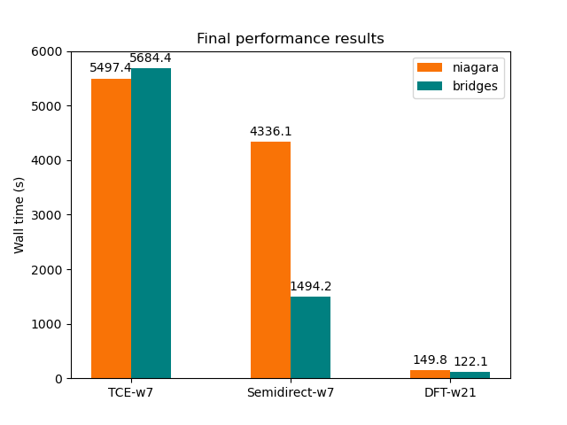
Final performance results
There is still some imperfect performance result here.
TCE on Bridges-2 spends much time on CCSD iterations.
Semidirect input on Niagara spends more time on calculating the t2 vectors.
For DFT, we used a trick that runs only half of the cores on 4 nodes, which enables larger L3 caches per core.

Slide 15
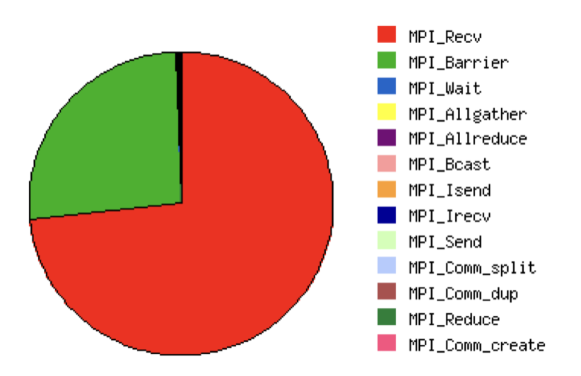
Profiling results
Although MPI_Recv consumed the most MPI communication time, the number of calls to MPI_Recv is roughly same to that of MPI_Isend, which is asynchronous and uses less time.
The communication pattern of Global Array is mostly send and receive.

Slide 16
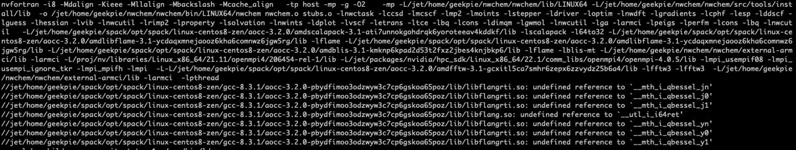
Difficulties
When we test with many compilers, BLAS and MPI libraries, compilation problems, runtime segmentation faults, and out of memory occurs.
For example, AOCC’s flang compiler does not support 15 dimension arrays in f08, but some MPI’s mpi.fh has this defined, hence we cannot utilize this combination.
Sometimes when we try `strange` combinations like compiling NWChem with NVHPC and AOCL, we have linking errors, and I manually link the NWChem binary with -L[shared library containing the missing symbol]

Slide 17
Lessons learned
Choose the suitable libraries for your architecture
MKL for Intel, AOCL for AMD, etc
Multi-node scaling is much harder than shared-memory setting
Performance may vary significantly with multi nodes and single node
Under some configurations, single node runs faster does not imply that configuration with multi nodes are similarly faster.
When MPI cannot get decent scaling result, turn to OpenMP
MPI often performs better than OpenMP even on shared-memory systems since the programming paradigm for MPI enforces better data locality and can avoid false sharing.
But when the data size is small compared to the number of cores, set OpenMP thread number to 2 or 4 may outperform pure MPI.
HPC programming diagram and interface: ARMCI and Global Arrays

Slide 18

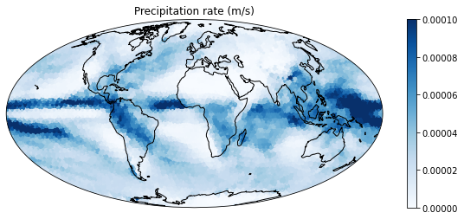
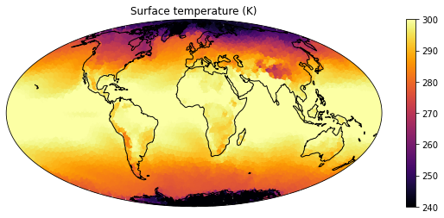
ICON
a unified next-generation global numerical weather prediction and climate modelling system
Atmosphere and Ocean components
in Grid Point Space on a Geodesic Icosahedral Grid
MPI Application

Slide 19
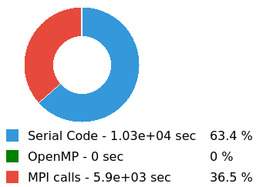
ICON
MPI Bound!
MPI Tuning
Serial Code Tuning

Slide 20
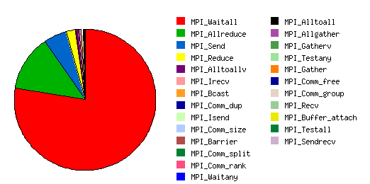
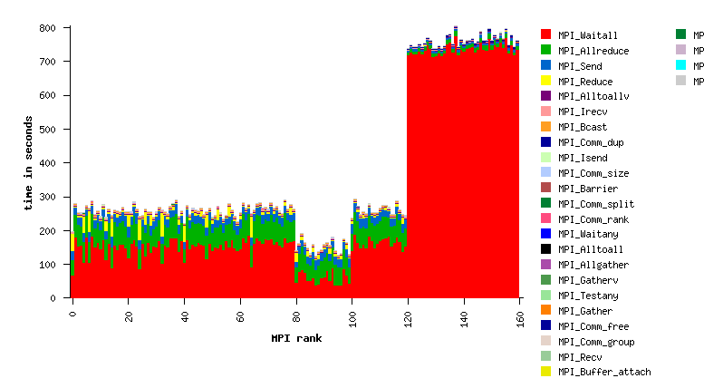
ICON MPI Tuning
IPM Result (Primary MPI Profiling)
Why 40 MPI Rank Having more MPI_WAIT time than others?
How to Reduce MPI Call time and Balance MPI?

Slide 21
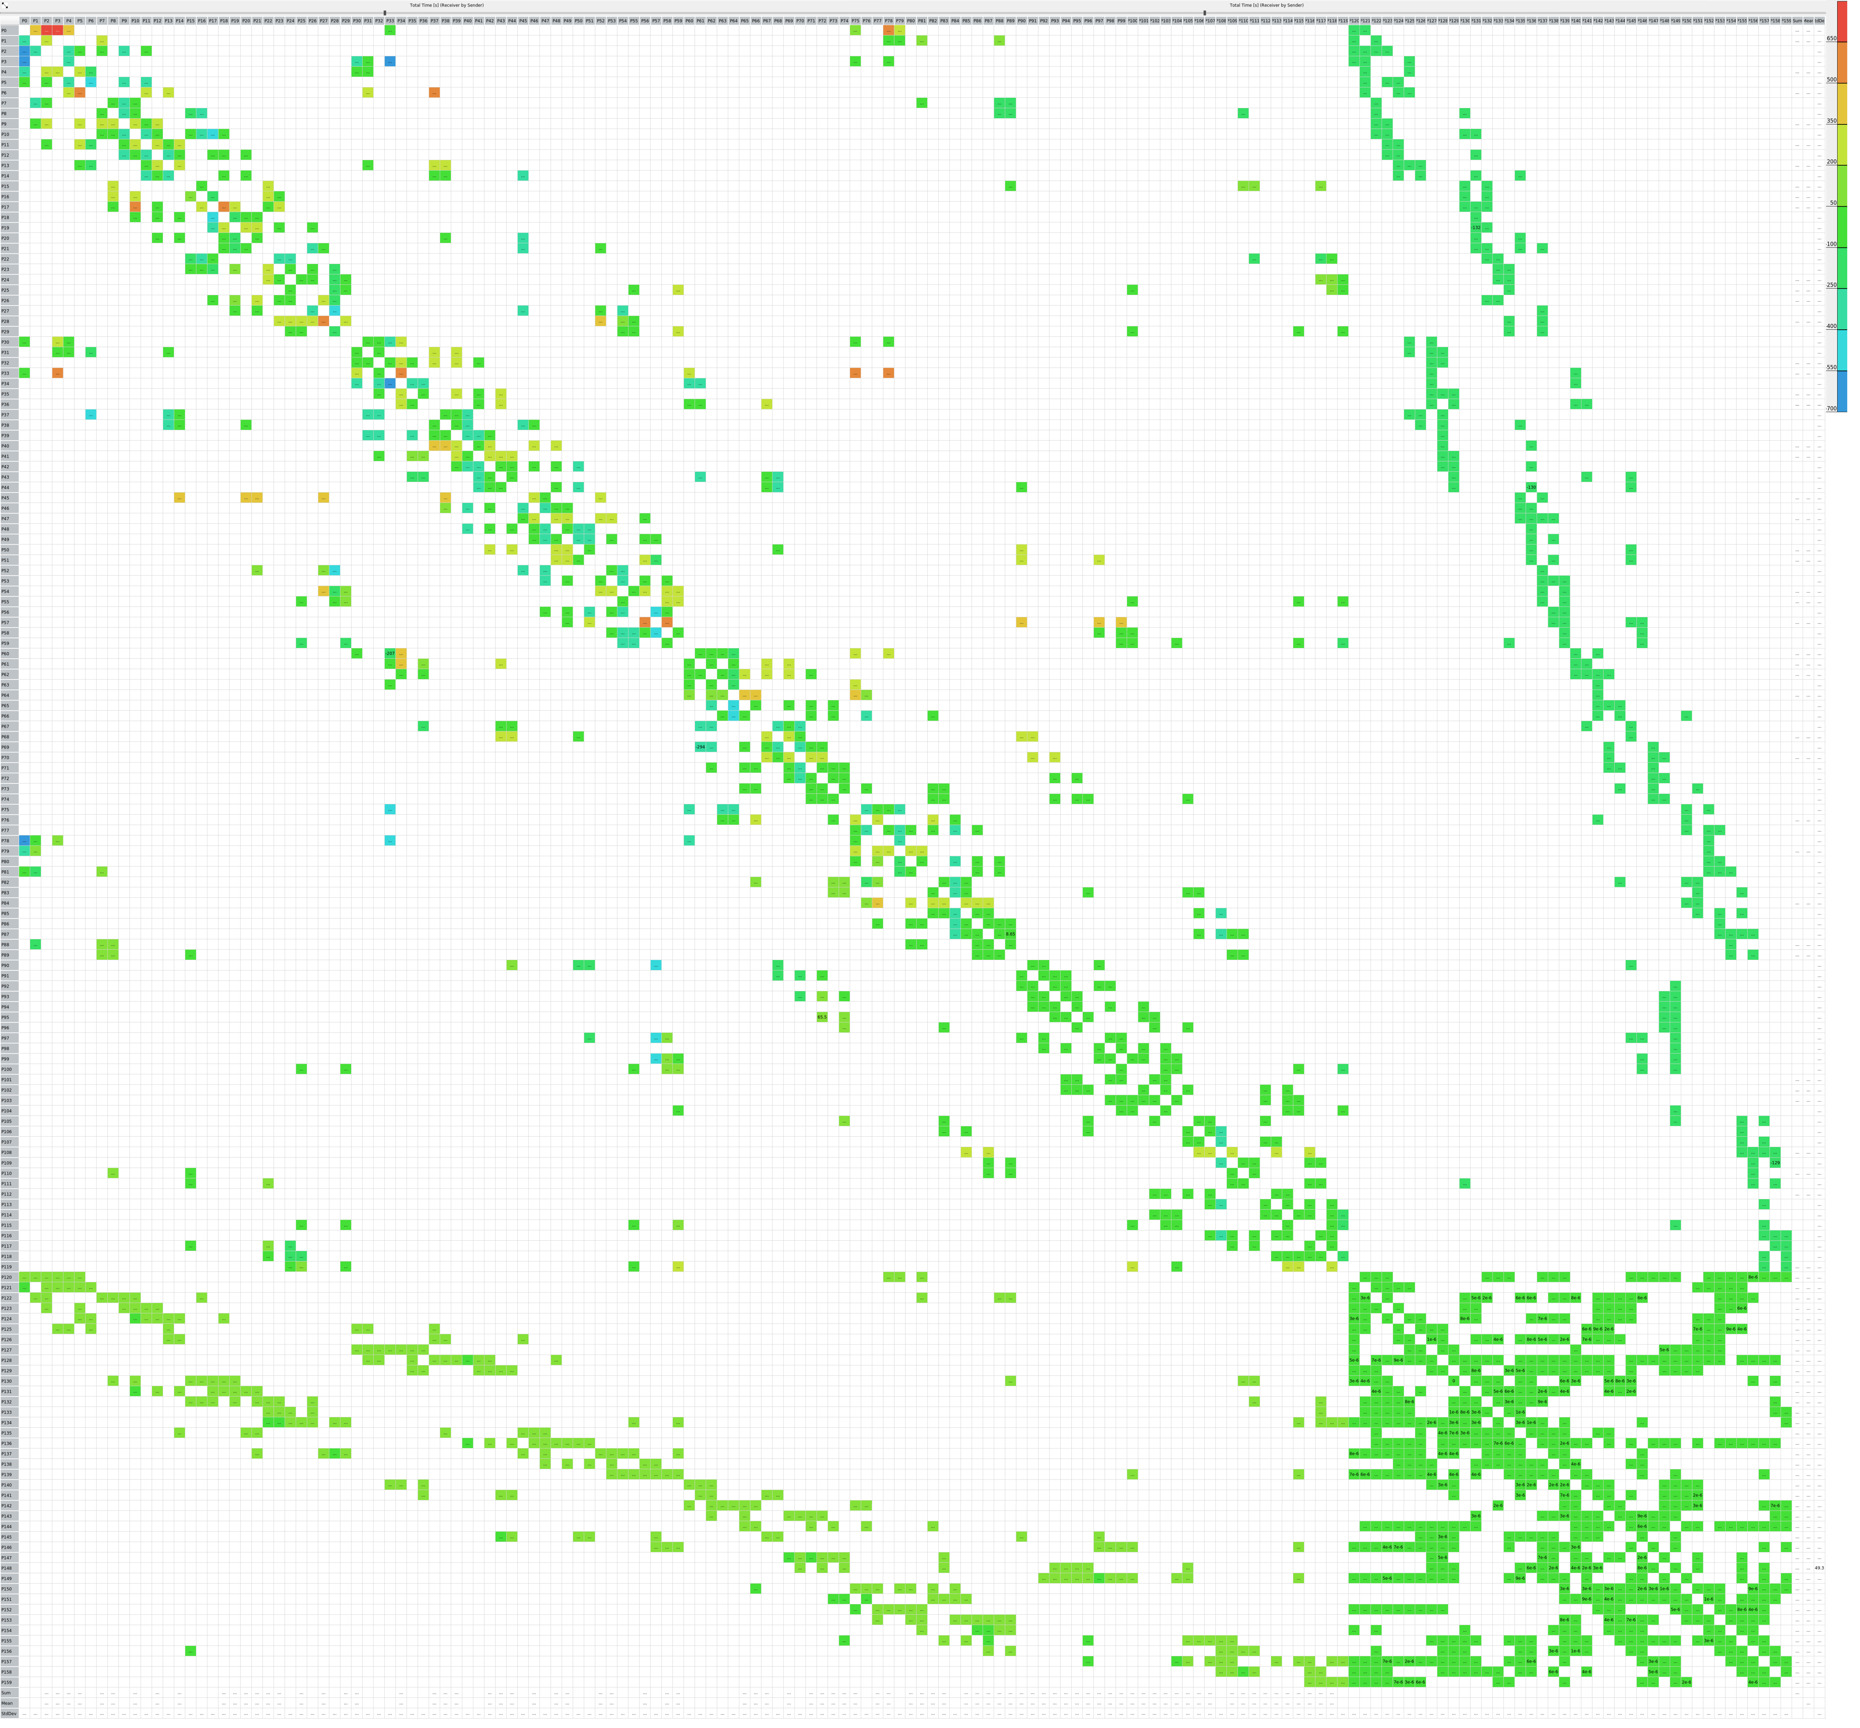
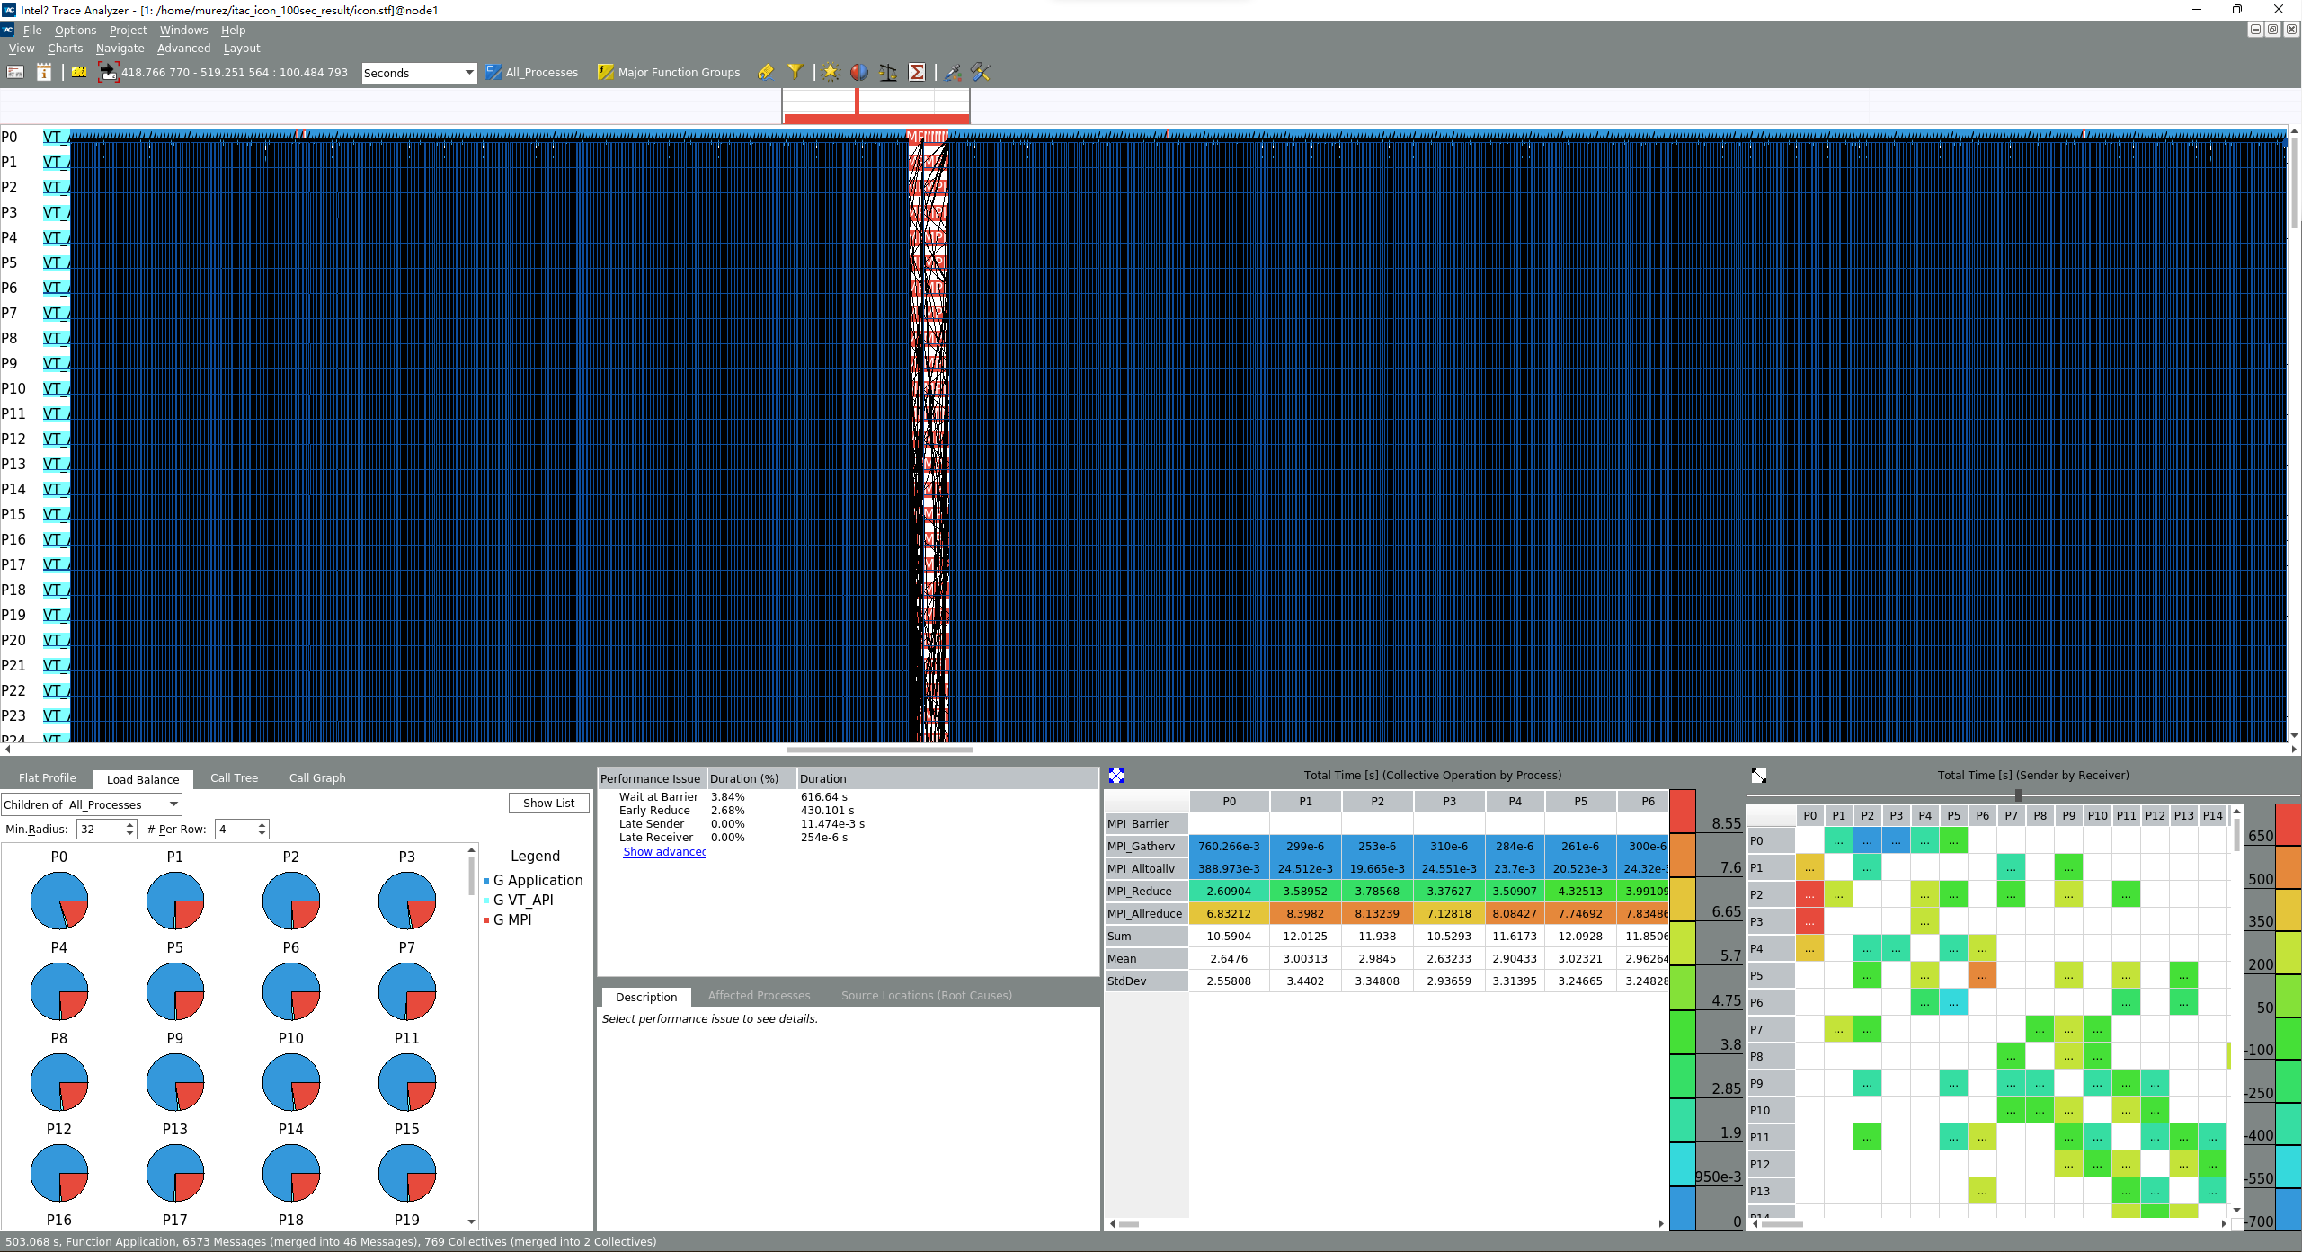
ICON MPI Tuning
Intel® Trace Analyzer and Collector (Detailed MPI Profiling)

Slide 22
ICON MPI Tuning
Intel® Trace Analyzer and Collector (Detailed MPI Profiling)
MPI Message Matrix

Slide 23
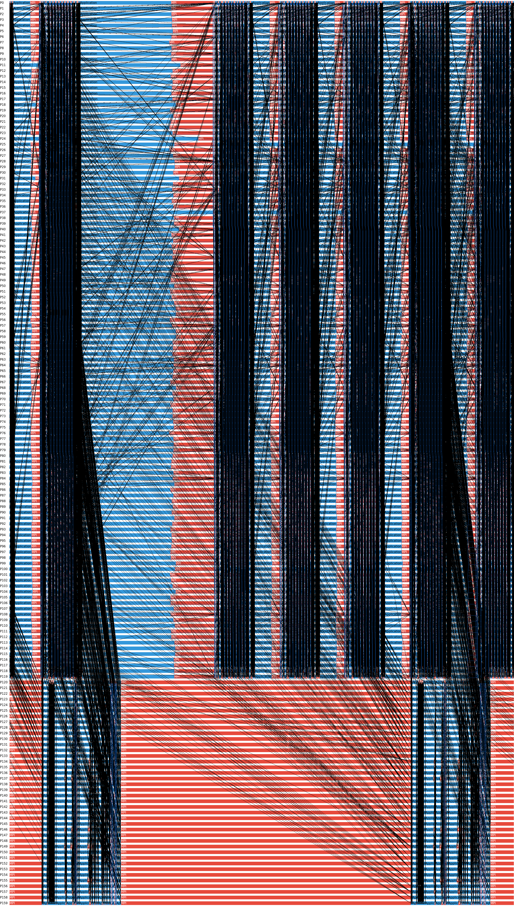
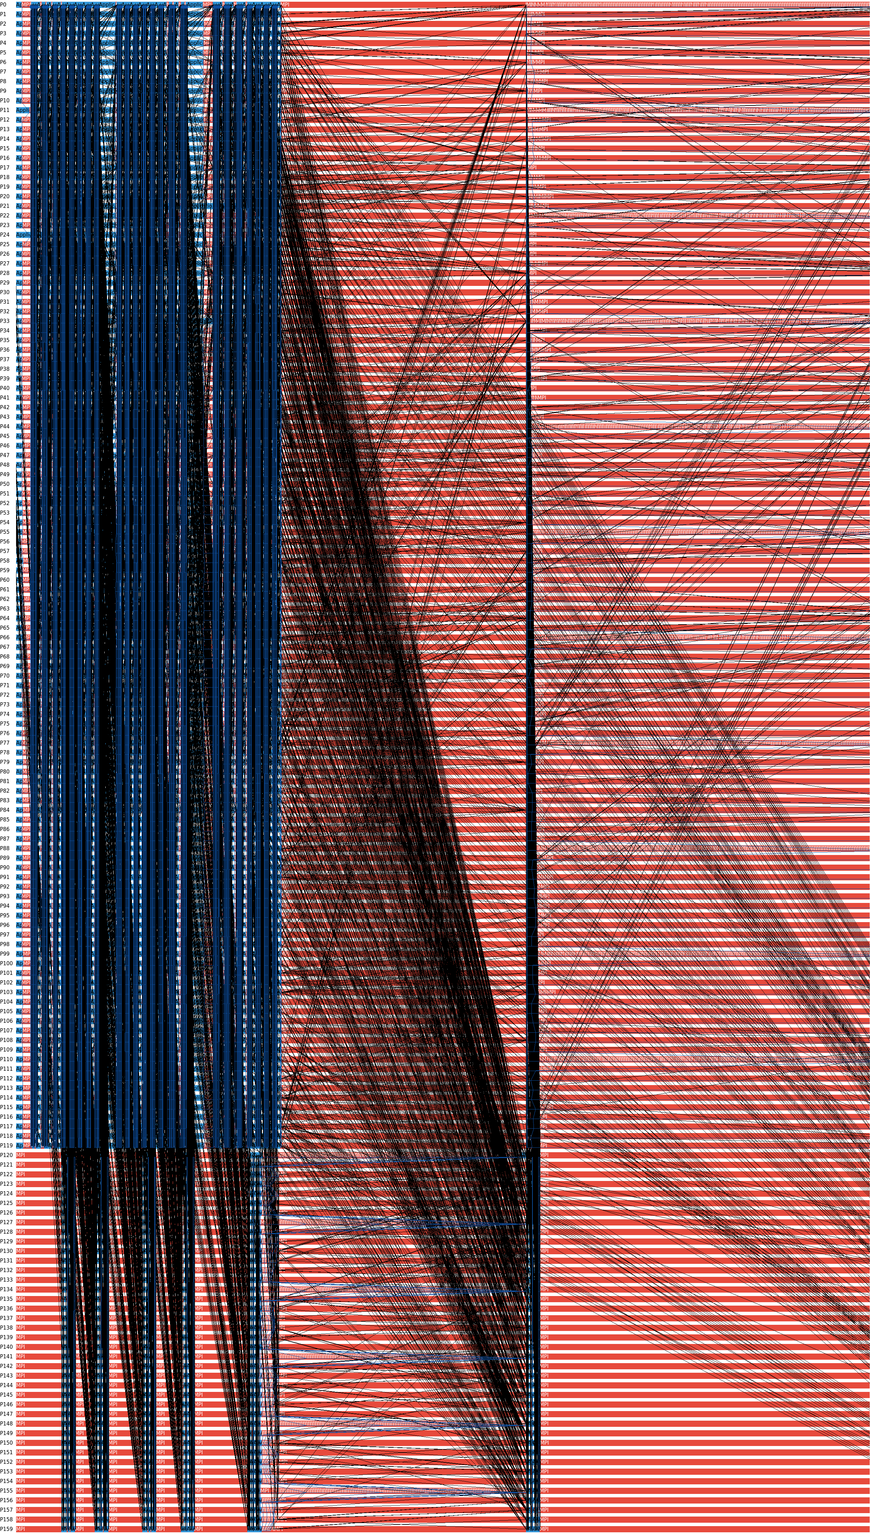
ICON MPI Tuning
Intel® Trace Analyzer and Collector (Detailed MPI Profiling)
MPI Trace
MPI Pattern 1
MPI Pattern 2

Slide 24
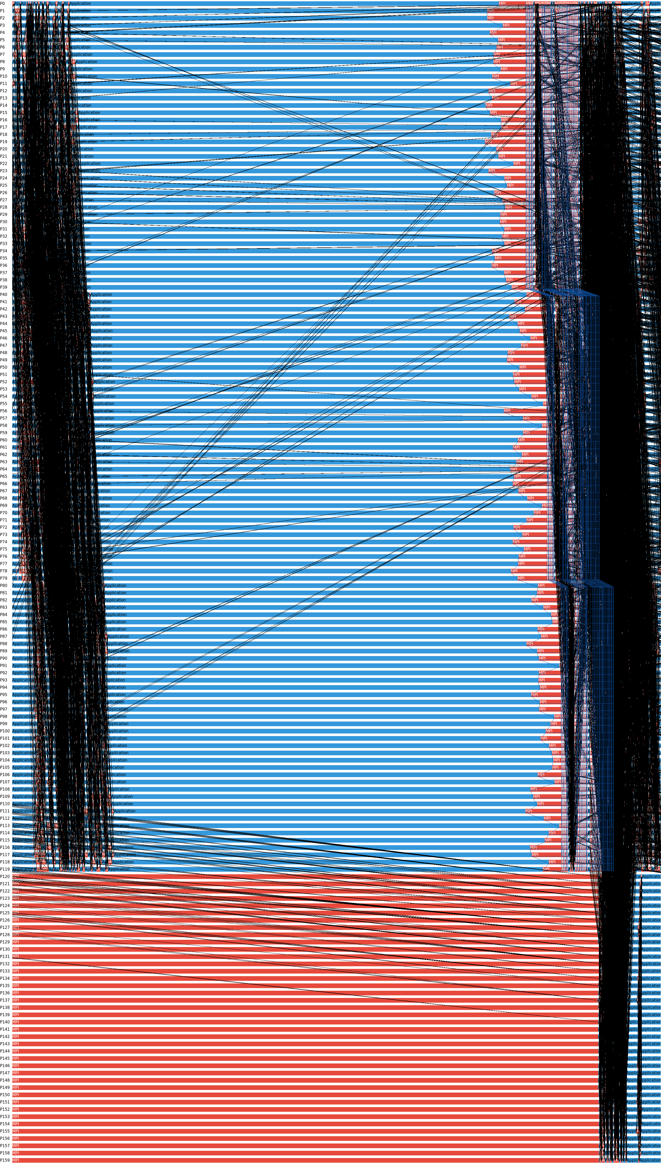
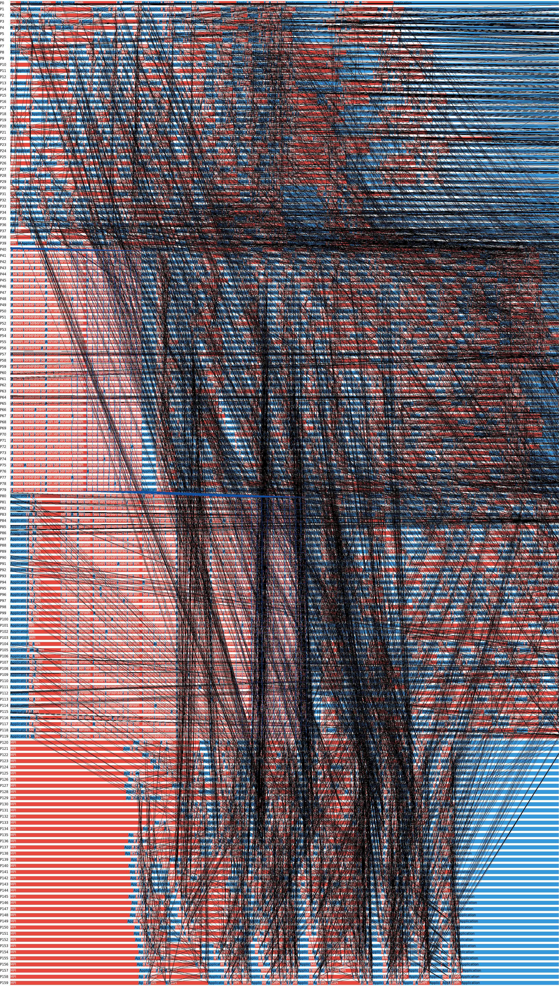
ICON MPI Tuning
Intel® Trace Analyzer and Collector (Detailed MPI Profiling)
MPI Pattern 1
MPI Pattern 1 Barrier
Ocean Ranks
always
Waiting
for
Atmosphere Ranks

Slide 25
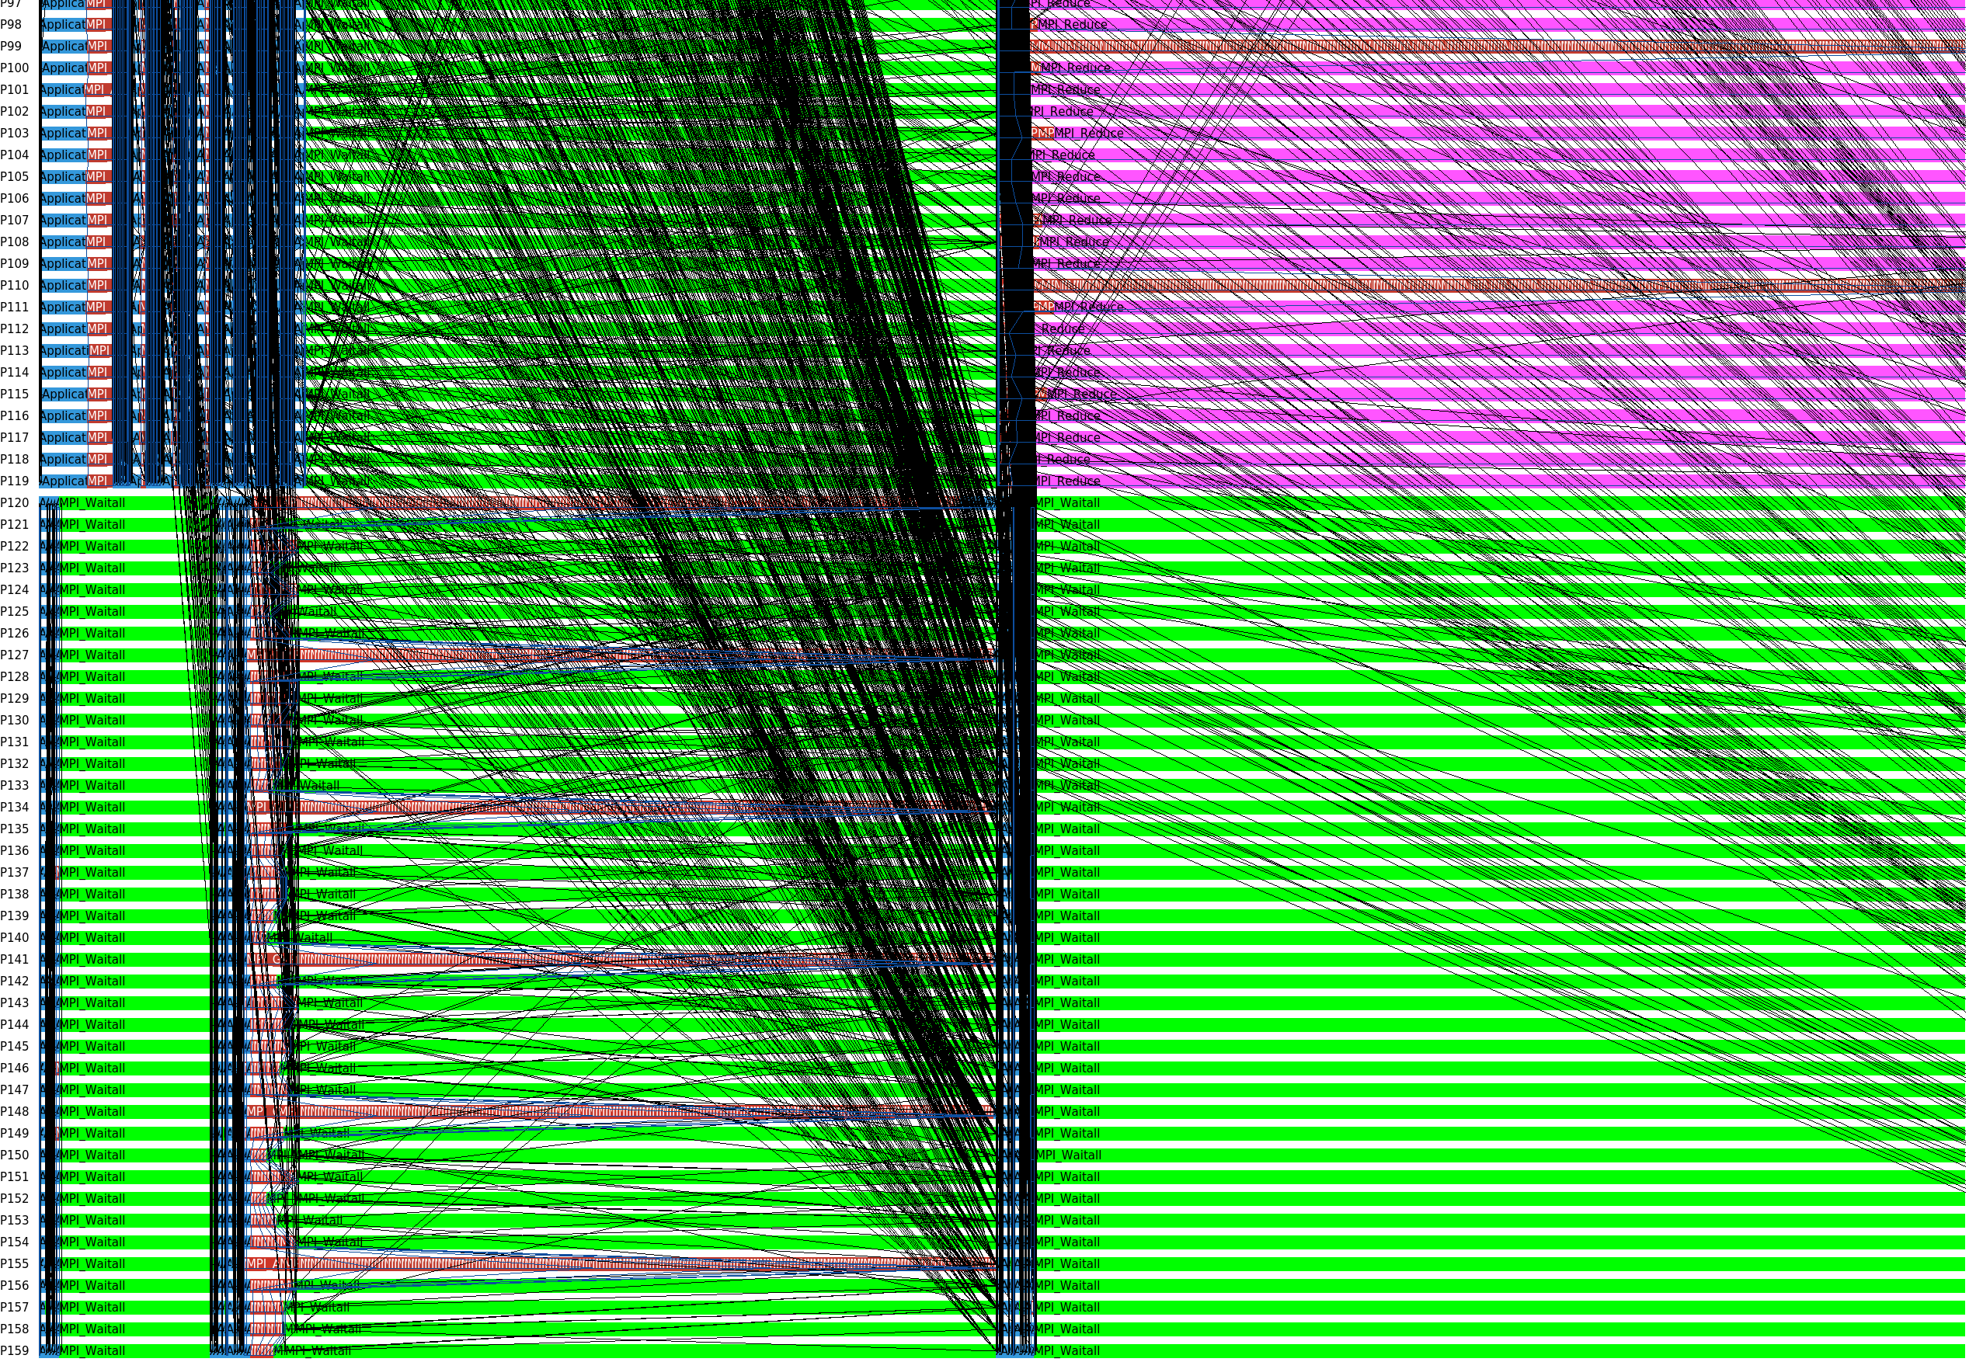
ICON MPI Tuning
Intel® Trace Analyzer and Collector (Detailed MPI Profiling)
MPI Pattern 2
MPI_Reduce
MPI_Waitall

Slide 26
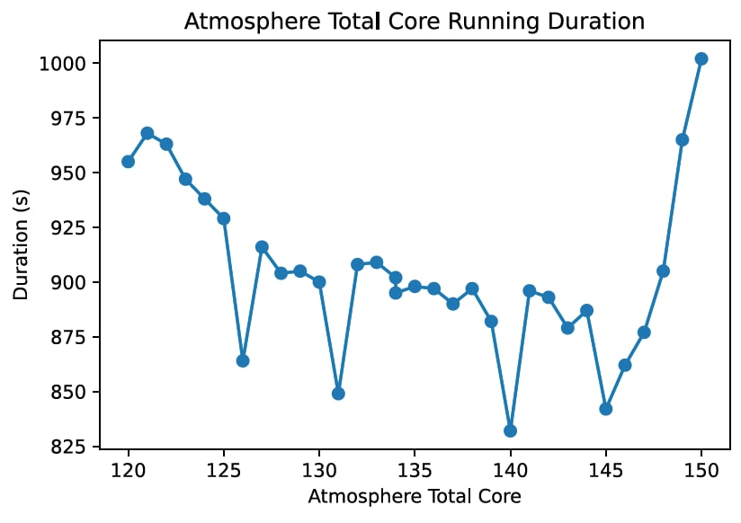
ICON MPI Tuning
Ocean Procs Tuning
20 Ocean, 140 Atmosphere Ranks @ Niagara
36 Ocean, 476 Atmosphere Ranks @ Bridges2
block:block

Slide 27
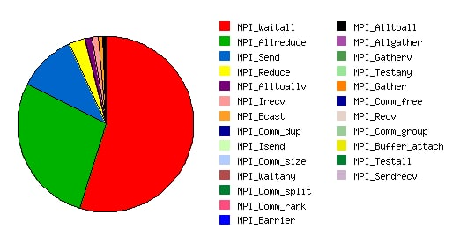
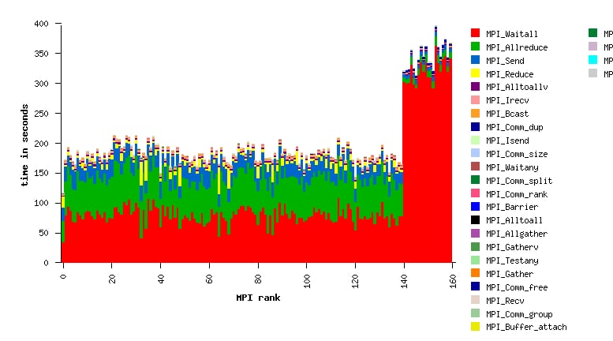
ICON MPI Tuning
Ocean Procs Tuning
20 Ocean, 140 Atmosphere Ranks @ Niagara
36 Ocean, 476 Atmosphere Ranks @ Bridges2
block:block

Slide 28
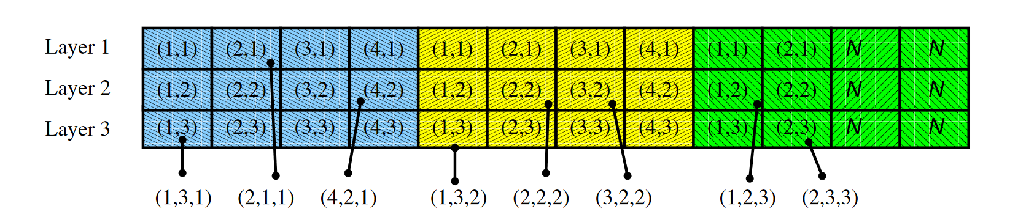
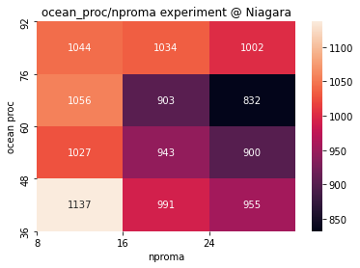
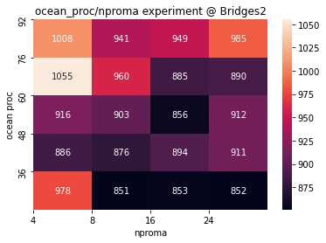
ICON Serial Code Tuning
Nproma Tuning
Vectorization and SIMD
AVX512 with Intel
AVX2 with AMD

Slide 29
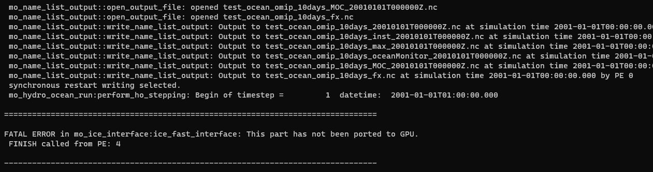
ICON Things can be Improve
GPU Version
Increase MPI affinity with slurm at Bridges-2
Additional work on slurm's CPU Management

Slide 30
Lessons learned
Always notice the Communication Pattern of a MPI Application
When a MPI application separates its ranks to do the different jobs, the load balance must be taking into consider.
A Detailed MPI Trace Profile is Important
A detailed profiling result can tell you more about the data dependency and the bottleneck.
Different Architecture have different Vectorization Ability

Slide 31
Xcompact3d-Preamble and Running Test
Multiple FFT backend: generic, fftw, and intel mkl.
When we use fftw as the FFT backend, we will get an improvement around 3% on our zen2 cluster, the performance may be different on other platforms.
There is no significant performance difference between mpi and ibv.
The hotspots of running different examples are rather different.
We will cover this later when we talk about the code structure.
We only optimize some part of the source code that are related to problem.
Tuning parameters works well.
The MPI workload(comm ratio) is high, especially on Bridges2.
This will be discussed in next few slides.
When performing the visualization, IO is critical(25% of the wall_time).
FFT backend | wall_time
generic | 353.841614
fftw3 | 338.326508
mkl | 354.947083

Slide 32
Xcompact3d-Profiling
What do the CPU process?
The program include three module that task much time in the specific input.
Compute turbines
Solve Poisson equations
Solve the transport equations
FFT calculations do not take so much time (in that specific input)
Which explains why the performance difference between FFT implementations are small.

Slide 33
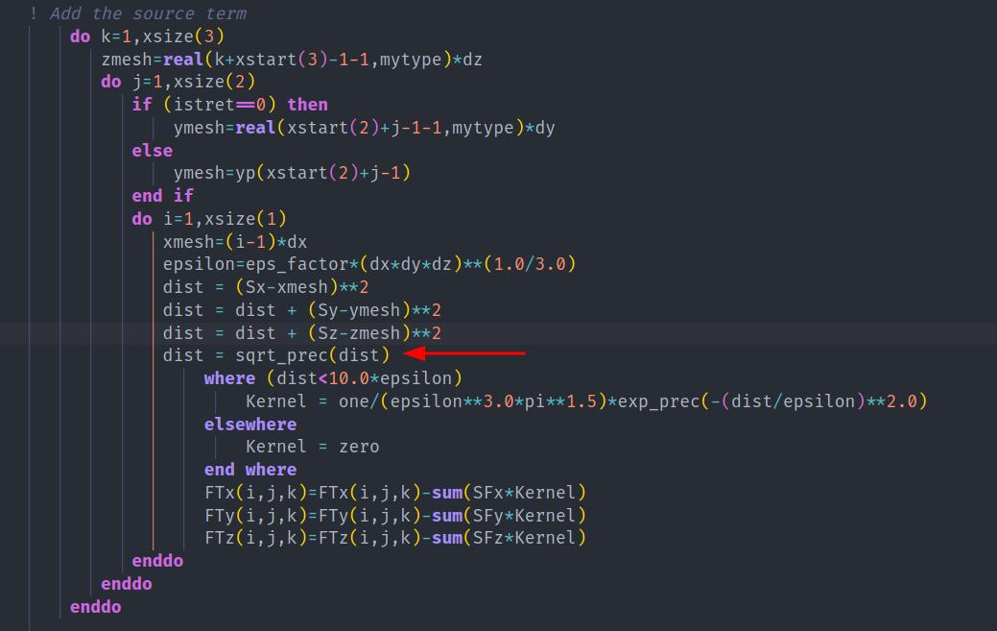
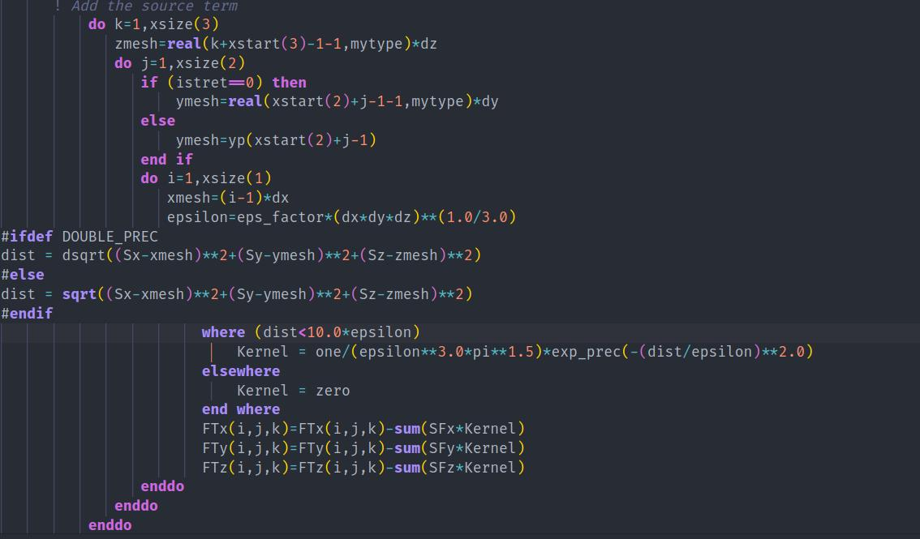
Xcompact3d-Profiling
Profiler: Arm Forge, Version 21.1
The main computation lays in acl_source.f90, and the hotspots are easy to observe, and we optimize them.
Further optimizations will be discussed in Code Challenge.

Slide 34
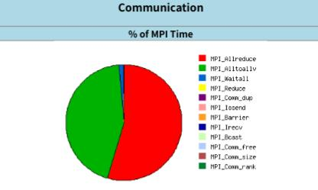
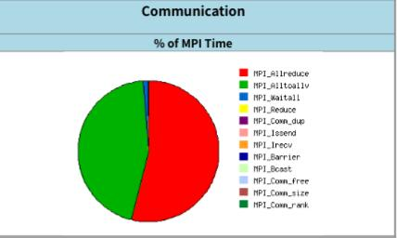
Xcompact3d – Parameter Tuning
In a single node with 64 cores(number of iterations are modified):
p_row | p_col | wall_time(s)
32 | 2 | 570.364
16 | 4 | 543.307
8 | 8 | 542.956
4 | 16 | 557.207
2 | 32 | 579.065
The wall_time is quite similar, and so do the MPI proportion.
16x4
8x8
On the two machines, we breakdown
512 = 64 * 8
160 = 0 * 0 (some issues occurred)

Slide 35
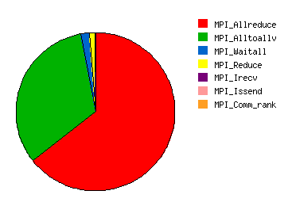
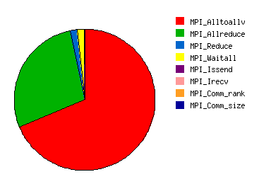
Xcompact3d – Result Overview
Profile
niagara
bridges2
 | Niagara | Bridges2
nodes | 4 (40 processes per node) | 4(128 processes per node)
wall_time(min) | 21.40334 | 22.20858
Average time step(s) | 0.5136803 | 0.533005893
Performance
Considering the significant different core usage between Niagara and Bridges2, the performance on bridges2 is not ideal.

Slide 36
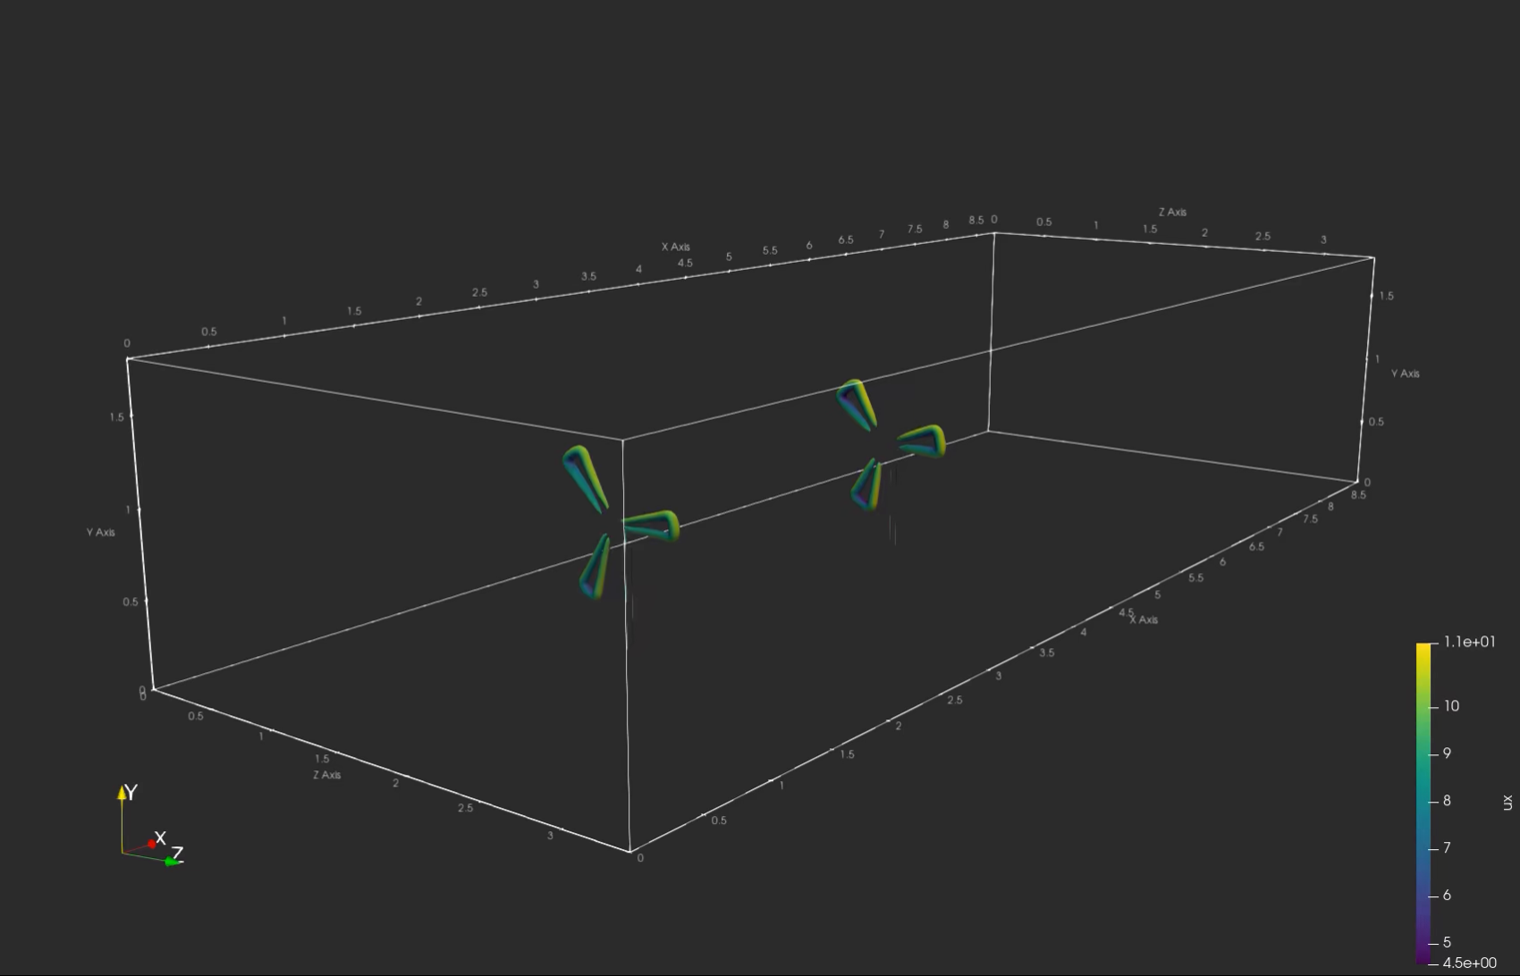
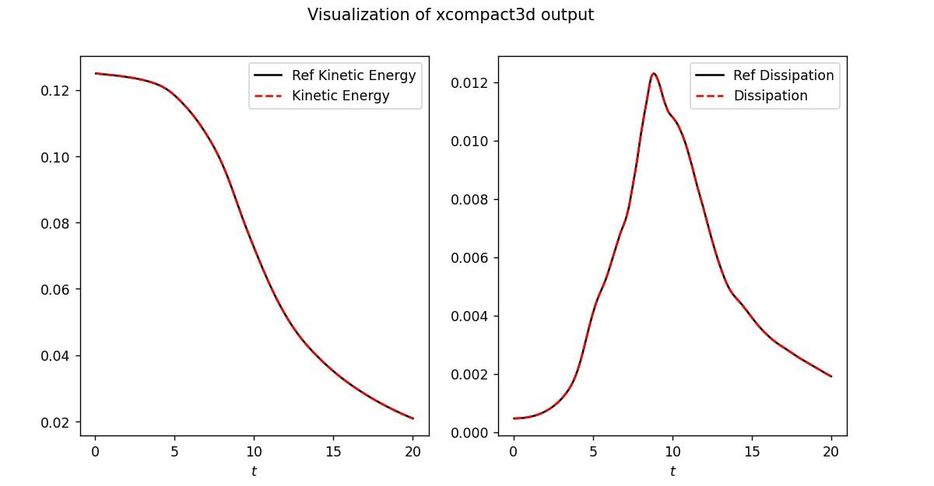
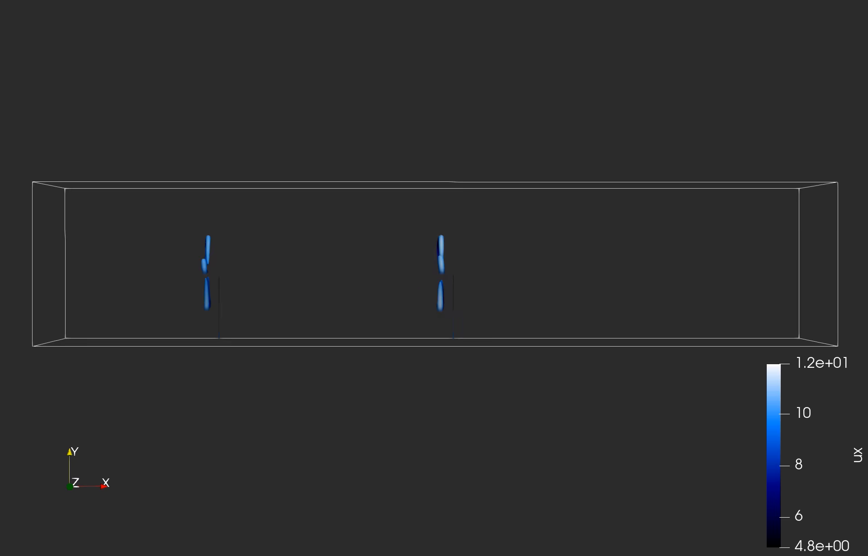
Xcompact3d – Result Overview
Visualization

Slide 37
Code Challenge for ISC22
How do we improve the performance of Incompact3d
Jiajun Cheng (Optimizing & profiling), Zike Xu (Deploying & Compiling)

Slide 38
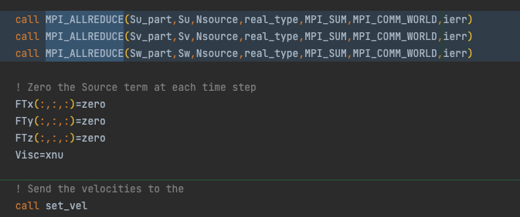
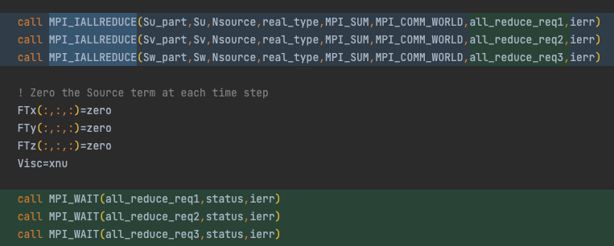
Code optimization
Make it non-blocking
By supplanting the blocking MPI calls to non-blocking MPI calls, we can do multiple AllReduce in parallel.
Non-blocking MPI calls enable Mvapich2-DPU to offload data to DPU.
If there are heavy computations, between the IAllReduce and Wait, we can save a lot of time.

Slide 39
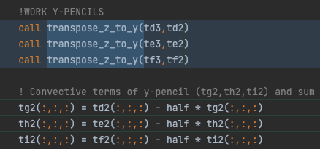
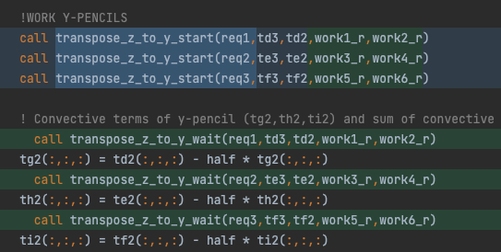
Code optimization
Make it non-blocking
By supplanting the blocking MPI calls to non-blocking MPI calls, we can do multiple AllReduce in parallel.
Non-blocking MPI calls enable Mvapich2-DPU to offload data to DPU.
This is an example that there are computations between transpose_start and transpose_wait.

Slide 40
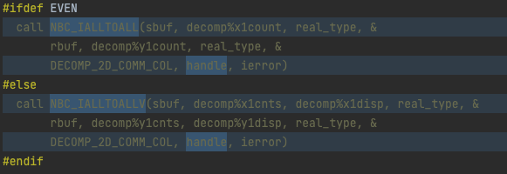
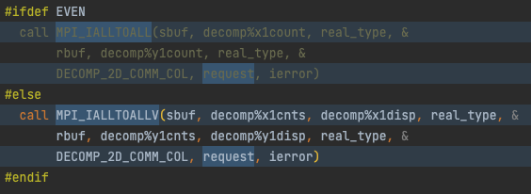
Code optimization
Make it non-blocking (in detail)
We removed the dependency relationship between Incompact3d and Libnbc.
We did some Api conversions. For example, we replace NBC_IALLTOALL with MPI_IALLTOALL and NBC_WAIT to MPI_WAIT.

Slide 41
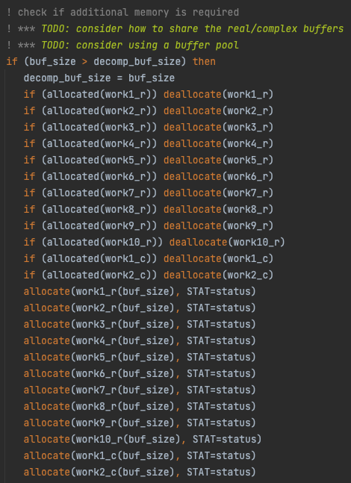
Code optimization
Make it non-blocking (in detail)
We must keep the buffer that we passed into the transpose_start unchanged during the non-blocking call. Therefore, we need buffers.
To make a prototype, we simply increase the number of buffers. We can make a buffer pool when we have more time.

Slide 42
Code optimization
Make it non-blocking (in detail)
The key concept of making a blocking process into a non-blocking process is to calculate the data dependency relationship between variables, i.e., to trace the data flow.
The variable relationship is shown in the figure. We can see that we can calculate these arrays in parallel.

Slide 43
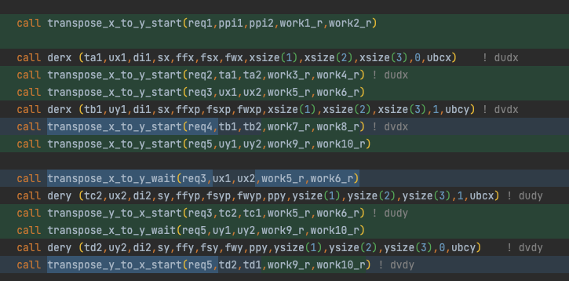
Code optimization
Make it non-blocking (in detail)
When the dataflow becomes complex, adapting the code to be non-blocking can be a nightmare. It is hard for human to trace the dataflow.
We think that compilers can handle this. By analyzing the AST, the compiler knows the dependencies between the variables. It can automatically turn blocking MPI calls into non-blocking MPI calls base on the dependency relationship.

Slide 44
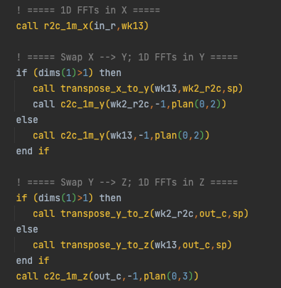
Code optimization
Make it non-blocking (in detail)
However, the optimizations that done by analyzing dataflow are limited, the figure shows an tough circumstance which can hardly optimized by analyzing dataflow.
The variables rely on each other very closely. When we get the data from the MPI calls, we immediately use the data. Therefore, there is no point changing the blocking MPI calls into non-blocking ones.

Slide 45
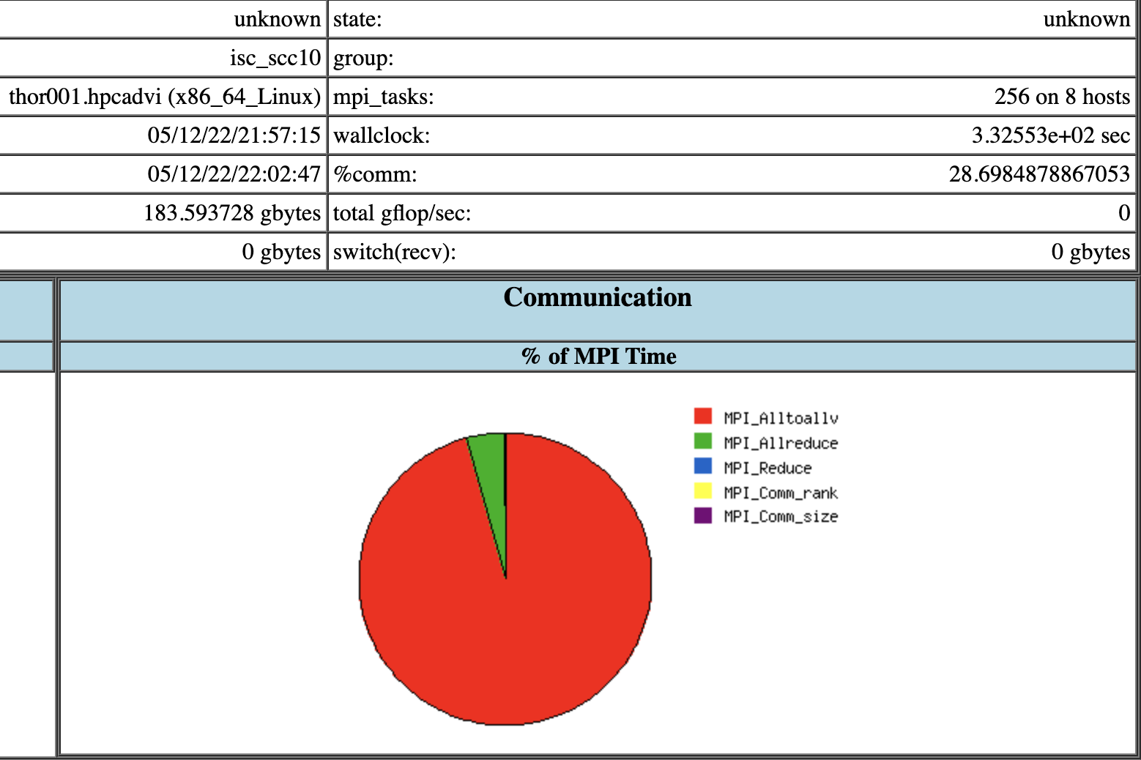
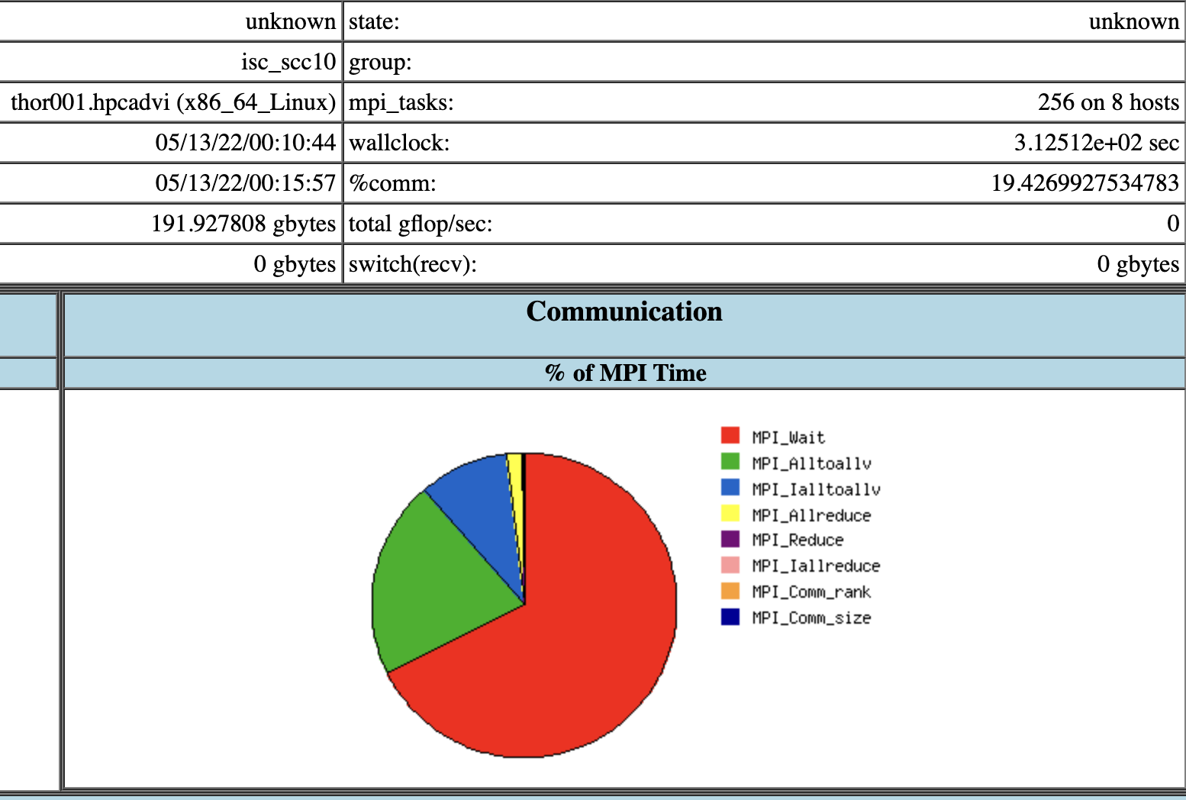
Code optimization
Make it faster
After we convert the blocking MPI calls into non-blocking MPI calls, we acquire an performance improvement around 6%, even without DPU offloading.
We noticed that a lot of MPI_Alltoallv are replaced by MPI_IalltoallV and MPI_Wait.

Slide 46
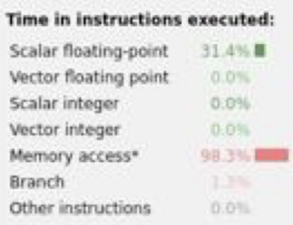

Code optimization
Make it faster
After we profiling the application, we found a hotspot.

Slide 47


Code optimization
Make it faster
The compiler fails to vectorize the calculation, and we help the compiler to optimize the code.
We inline the function sqrt_prec manually.
We use where statement and matrix operations, instead of manipulate the array element one by one.

Slide 48
Code optimization
Make it faster
Finally, we get a performance improvement around 40%.
The test data is based on the Xcompact3d for ISC22, not Code challenge.

Slide 49

DPU offload
When the message size is between 16KB and 512KB, the MPI will perform a DPU offload.
When the message size is less than 8KB or more than 1MB, the MPI will not perform a DPU offload.
The overlapping can cover the cost of MPI communication.
Mvapich2-DPU only supports offloading non-blocking MPI calls to DPU.

Slide 50

DPU offload
In our case, the speed up is not so obvious.
Compare to the command line output in the last slide (which shows the result of using DPU offloading), the overlap decrease significantly.
However, the wallclock between two modes (with DPU offloading and without DPU offloading) are very close.

Slide 51
DPU offload
Different buffer size
PPN / Buffer Size / Kind | Alltoallv | Ialltoallv | Allreduce | Reduce | Iallreduce
4 | 1M/512K | 1M/512K | 8 | 8 | /
8 | 256K | 256K | 8 | 8 | 2K
16 | 128K/64K | 128K/64K | 8 | 8 | 2K
32 | 32K | 32K | 8 | 8 | 2K
With the increase of PPN, we buffer size of Alltoallv and Ialltoallv becomes smaller and smaller.
We except when PPN is 8, 16, and 32, DPU offloading will make an effect, and a higher performance will be acquired.

Slide 52


DPU offload
However, the performance remains the same even though we enable the DPU offloading.
The upper image is DPU offloading disabled.
The other image is DPU offloading enabled.

Slide 53


DPU offload
However, the performance remains the same even though we enable the DPU offloading.
The upper image is DPU offloading disabled.
The other image is DPU offloading enabled.

Slide 54


DPU offload
However, the performance remains the same even though we enable the DPU offloading.
The upper image is DPU offloading disabled.
The other image is DPU offloading enabled.

Slide 55
Possible reasons
MVAPICH2 implements job balance between blocking MPI calls and non-blocking MPI calls quite well. DPU is unnecessary in this circumstance.
The topology of Thor cluster has some issues.
We do not use the correct network device.
We configured the runtime wrongly (which is the least possible, since we get the reasonable overlapping result from the OSU MPI Non-blocking All-to-All Latency Test).

Slide 56


Weak Scalability
We keep every process handle the same amount of data.
For example, the nx, ny, and nz for PPN=8 is 323. The nx, ny, and nz for PPN=16 is 512.
512*512*512/256 = 524,288
323*323*323/64=526,535

Slide 57
Weak Scalability
Different buffer size
PPN / Buffer Size / Kind | Alltoallv | Ialltoallv | Allreduce | Reduce
8 | 428K/512K | 428K/512K | 8 | 8
32 | 1M | 1M | 8 | 8
With the increase of PPN, we buffer size of Alltoallv and Ialltoallv becomes larger.
It seems that the buffer is larger than 512K, so DPU offloading may not make a difference.

Slide 58
Weak Scalability
Different performance
We keep every process handle the same amount of data.
With the increase of PPN and the problem size, we find that the time increase significantly.

Slide 59
Strong Scalability
Different performance
We keep every process handle the same amount of data.
With the increase of PPN and keep the problem size unchanged, we find a pretty good strong scalability.
We do not successfully submit the job 8x8 ppn8 with DPU, so we use the data 8x8 ppn8 without DPU instead.

Slide 60
Difficulties
We failed to pass environment variables such as IPM_LOG=full to Xcompact3d, so we change the source code of IPM and set the log level manually.
The Makefile of Xcompact3d is not well written. We cannot compile successfully when the make job count is greater than 1. Therefore, we wrote CMakeLists.txt and use Cmake to compile the project.
When we use FFTW3 as FFT backend, the FFTW3LibraryDepends.cmake is missing, which is required by FFTW3Config.cmake. This issue has been existed for 4 years, which still has not been solved (see https://github.com/FFTW/fftw3/issues/130).
We removed the dependency relationship between FFTW3Config.cmake and FFTW3LibraryDepends.cmake.
We will make a pull request to fix the problem as soon as possible.

Slide 61

Lessons learned
Submit jobs as early as possible
Thanks David, he enable us to complete all the jobs.
Use build system like Spack can improve application performance and save time
We can switch between different FFT implementations by configs.
We only meet a little compile problem with the help of Spack.
Making custom Spack package is easy (What we write is actually a DSL).
Non-blocking calls can make better use of system resource
This concept has been widely used, like the “async” keyword in programming languages, non-blocking MPI calls and message queue.

Slide 62
Innovation
Describe an application that you took and can demonstrate innovation work upon
Using Intel MPI and Intel® Trace Analyzer and Collector to improve MPI Profiling.
Using Arm Forge to Find Hotspots in Code level.
Analyzing the FP ALU usage to diagnose the degree of vectorization.
Changing blocking MPI calls into non-blocking MPI calls in Xcompact3d.
Using Spack as the build system during the competition.
Putting forward the idea of changing the blocking MPI calls into non-blocking MPI automatically by compilers.
Discussing the weak scalability and strong scalability about Xcompact3d.

Slide 63
Q&A

